Slide 1



KA220-SCH - Cooperation partnerships in school education
Strengthening & spreading the Toolbox for (self-)Evaluation and Stimulation Social Inclusion in Education
Cooperation partnership in school education – KA220
Multiplier event- The Hague
November 21th, 2025

Slide 2
Erasmus+ KA220 - Objectives
Cooperation partnerships
• Increasing quality in the work, activities and practices of organisations and institutions involved, opening up to new actors, not naturally included within one sector;
• Building capacity of organisations to work transnationally and across sectors;
• Addressing common needs and priorities in the fields of education, training, youth and sport;
• Enabling transformation and change (at individual, organisational or sectoral level), leading to improvements and new approaches, in proportion to the context of each organisation.

Slide 3
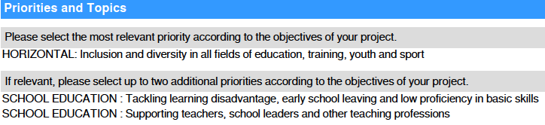
Why this project ? → Erasmus+ Priorities

Slide 4





STESSIE was born…

Slide 5
Why this project ? → objectives
3 specific objectives:
SO 1 – "Scientific evaluation, optimization and translation of the toolbox for (self-)evaluating and stimulating social inclusion in education",
SO 2 – “Training of inspectors, evaluators, education providers, school leaders and teachers in the partner countries on why they should and how they could use and interpret the toolbox TESSIE 2.0”
SO 3 – “Spreading of the toolbox TESSIE 2.0 in different European regions: actively participate on policy level in the international debate about evaluation and quality improvement of social inclusion in education by raising awareness amongst the broader public about the existing tool and spreading the use of it".

Slide 6
STESSIE expected results
The concrete results:
1) Scientific evaluated and upgraded TESSIE 2.0 framework
2) Scientific evaluated and upgraded TESSIE 2.0 (self-)evaluation and inspection tools and approaches in different systems
3) Professional online platform and online applications for all devices
4) Training and formation guidelines
5) Manual with criteria and strategy for internal evaluation
6) Manual with strategy for raising awareness and informing policy makers
7) Videos for the promotion of the TESSIE 2.0 tools

Slide 7
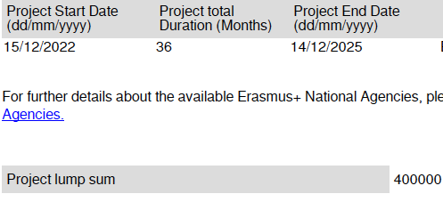
Project PLANNING

Slide 8
 | 2023 | 2024 | 2025
Jan
Feb | Kick-off - Brussels | TPM5 (online) | TPM9 (online)
Ma | TPM1 (online) | TA3 Basque Country + ME3 | TA6 Flanders + ME6
Apr | IT-TPM | IT-TPM
May | TPM2 (online) | TPM6 (online) | TPM10 (online)
Jun | TA1 Poitiers + ME1 | TA4 Bulgaria + ME4 | TA7 Estonia + ME7
Jul
Aug
Sep | TPM3 (online) | TPM7 (online) | TPM11 (online)
Oct | TA2 Malta + ME2 | TA5 Serbia + ME5
Nov | IT-TPM |  | MULTIPLIER EVENT 8 (SICI)
Dec | TPM4 (online) | TPM8 (online) | Final meeting - Ghent

Slide 9
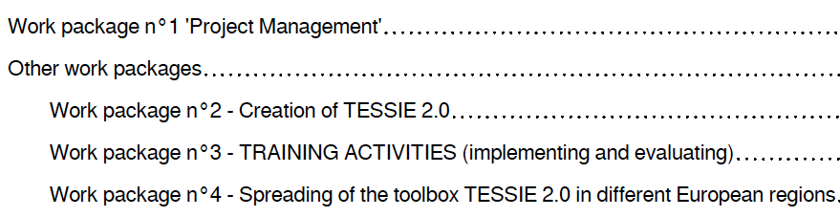
4 workpackages

Slide 10
WORKPACKAGE 1 : Project Management
Kick-off meeting
MSTeams
12 TPM online
Final meeting

Slide 11
WORKPACKAGE 2 : CREATION OF TESSIE 2.0
1. Scientific evaluation of TESSIE → STESSIE
2. Optimization of TESSIE→ STESSIE
Ghent University will took the lead for the assessment and research work
IH2EF took the lead for the creation of the online application and for making the formation and training
guidelines.

Slide 12
WORKPACKAGE 2 : CREATION OF TESSIE 2.0
IT-TESSIE team developped the online application
during 3 IT transnational project meetings.
budget for 3 IT transnational project meetings (IT TPM's):
3 - 4 days event (travel days included)
Subsistence: € 190/day = 760 EUR,
Return journey: between 500 - 1999 km: € 275 (partners from Belgium, Spain, Malta and Serbia)
Return journey: between 2000 - 2999 km: € 360 (partners from Bulgaria and Estonia)

Slide 13
WORKPACKAGE 2 : CREATION OF TESSIE 2.0
Budget for evaluation and assessment of TESSIE on a systemic European level: € 35 000,00 (University Ghent)
(01/02/2023 - 31/05/2023)
Budget for professional website building: € 20.000,00 (SICI)
(01/01/2023 - 30/11/2025)
Developping a solidly configured online application, useful on
computers and other devices (phones, tablets…): € 20.000,00 (IH2EF)
(01/01/2023 - 30/06/2024)

Slide 14
Work package n°3
TRAINING ACTIVITIES
(implementing and evaluating)
Specific objectives:
1) Training of inspectors, evaluators, education providers, school leaders and teachers in the partner countries
2) Translation of the toolbox and the formation and training guidelines
7 training activities or 146 mobilities → € 182500 EUR
5 days (travel days included), € 1250 per person
12 mobilities for each partner
(2 participants to 6 training activities in another country)
12 x € 1250 = € 15000/ partner
14 mobilities for external experts
paid by the coordinator = 14 x € 1250 = € 17500

Slide 15
Work package n°3
TRAINING ACTIVITIES
(implementing and evaluating)
Training activities with:
'pilots/jobshadowing in schools’
2 persons from each partners
2 invited experts (INGESSIE).
    professionalization in a team has a greater impact
    greater influence in the dissemination with colleagues
4 parts
Part 1: Workshop with the highlights of the (national) educational and supervisory system of external evaluation with focus on inclusive education in schools.
Part 2: Workshops with the input of the invited experts.
Part 3: 'peer-training’ or job-shadowing' in schools (at least 4 or 5 visited schools).
Part 4: Reflection sessions (swotanalysis).

Slide 16
Work package n°3
TRAINING ACTIVITIES
(implementing and evaluating)
Cost for PROJECT DELIVERABLES
TRANSLATIONS: € 13500 x 80% = € 10800
€ 1200 for each language and € 1300 for Dutch (€ 100 divided among the Flemish partners, for adjusting the lumpsum budget)
(Dutch, Bulgarian, English, French, Estonian, Serbian, Spanish, Valencian and
Basque) So: € 10900

Slide 17
Work package n°4
Spreading the toolbox TESSIE 2.0
Objectives:
1. Spreading of the toolbox TESSIE 2.0 in different European regions
2. Actively participate on policy level in the international debate about evaluation and quality improvement of social inclusion in education by raising awareness amongst the broader public and by using the TESSIE 2.0 tools.
Multiplier event (after each training activity) for all stakeholders, from in and even outside the host country. Invite‘outsiders’ of the project, also from the neighboring countries.
€ 3.000/multiplier event

Slide 18
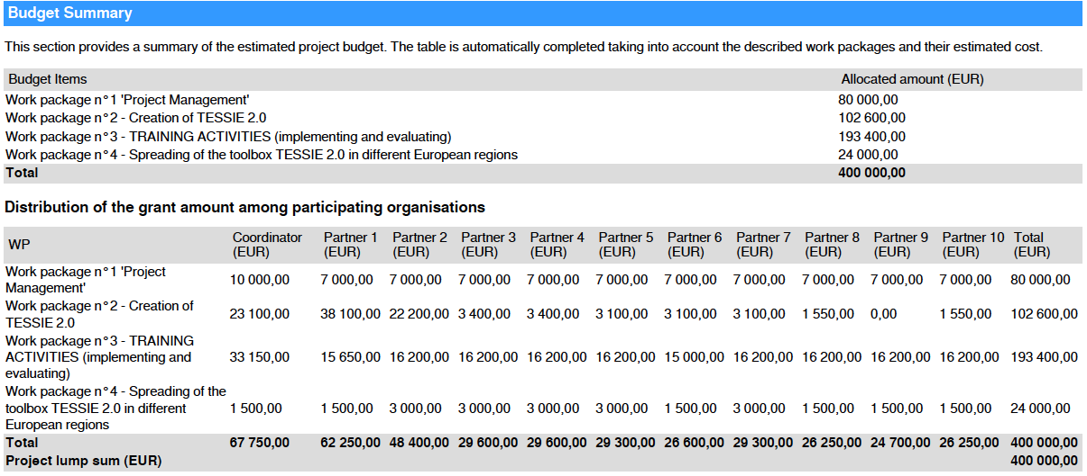

Slide 19
INGESSIE
During the project:
- set-up of a International Network Group: the target group were experts and stakeholders outside the projectpartners.
- during the kick-off meeting all partners gave their input and a list was made.
- before the training events, during the online transnational project meetings, was decided with all partners which 'external experts' are most relevant and were invited.
→ translation of STESSIE (website) in extra languages

Slide 20

https://www.sitemn.gr/stessie/

