Slide 1
Developing a sustainable system of quality assurance: empowering schools
Denise Gatt
Director
Directorate for Quality and Standards in Education
Malta

Slide 2
A journey towards sustainability:
Understanding Quality
Changing the mindset
A developmental approach towards external Quality Assurance
Developing a Sustainable system of Quality Assurance
A Quality Assurance Framework for Education in Malta
National Quality Standards in Education (0-3) (3-16)

Slide 3

Perception and mindset….
What is the existing perception in schools of quality assurance?
What approach is leadership taking towards understanding quality and Quality assurance?
How can we start changing the current perception and mindset which exists today in our schools?

Slide 4
Quality Assurance VS Quality Control
Quality assurance proactive
Quality control
reactive

Slide 5
External Quality Assurance: A developmental approach… Is it enough?
Promote Dialogue
Incite Self-Reflection
Constructive feedback
Clarity in conveying message
Targeted areas for development
Evidence based data

Slide 6
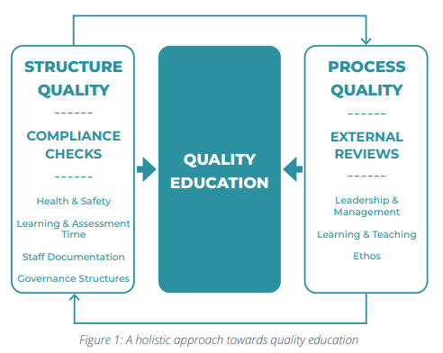
A holistic approach to Quality Assurance.

Slide 7
How can we ensure that quality assurance is effective in today’s educational landscape?
Understanding / Knowledge
Empowerment
Ownership

Slide 8
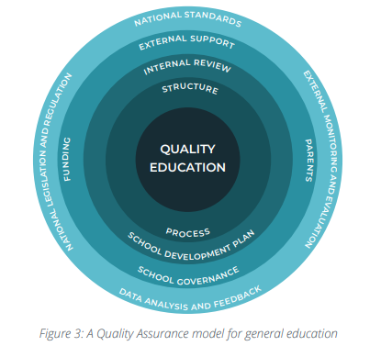
A Quality Assurance Framework for Education in Malta (0-16)

Slide 9



Quality Assurance – ECEC

Slide 10


Quality Assurance – (3-16)

Slide 11
National Quality Standards in Education
Improve the overall quality of education – benchmarks for schools to strive towards continuous improvement and excellence.
Promoting equity across schools and consistency in educational practices.
Facilitate accountability – the evaluation and monitoring of schools – both through internal and external quality assurance mechanisms.

Slide 12
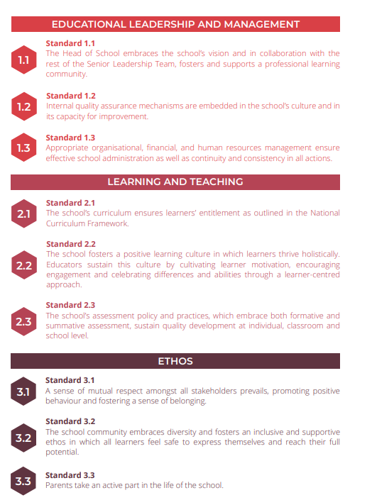
National Quality Standards – Structure

Slide 13
Feedback from educators during consultation process: ‘Not another document in our drawer…’
The need for a framework and standards especially in the everchanging educational scenario.
The importance of creating synergy between the framework, standards and other policies issued by the ministry
The need for a clear and concrete implementation plan
Developing a timely monitoring and evaluation system of the implementation process of both documents.

Slide 14
Implementation plan – Professional Development Sessions ‘Inspectors for an hour….. An exercise in self-reflection.’
Professional Development sessions in all schools in Malta and Gozo.
One Session with Senior Leadership Team and one with Educators
Case study approach – Educators become inspectors for an hour and discuss the approach of a particular teacher in light on the Standards on Learning and teaching
Reflection exercise on Standards and their needs as educators at the end of the session

Slide 15

Self-reflection exercise….
Describe one aspect from the quality markers that you aim to improve upon. Add your description under the appropriate quality marker.

Slide 16
Educators’ self-reflection exercise

Slide 17
National Quality Standards in Education (3-16) Quality Markers – Educators’ needs.
Quality Marker | Feedback
Teacher – Learning Support Educator collaboration | Time for better collaboration and communication
Learner-Centred | Need to use more learner centred strategies that engage learners in the learning process.
21st Century competences (clear awareness of the need to promote 21st Century skills) | More training in the use of digital technology especially in facilitating assessment. Lack of time/vastness of syllabus limits the use of digital technology Training on how to promote critical thinking.
Planning | Upskilling on how to make lessons more practical and engaging and plan according to learners’ abilities. Planning and using different teaching strategies.

Slide 18
National Quality Standards in Education (3-16) Quality Markers – Educators’ needs.
Quality Marker | Feedback
Formative assessment | Upskilling on how to provide learners with a wider variety of assessment strategies, including constructive feedback.
Learning environment | Educators would like to be upskilled on how to enrich the class learning environment with appropriate learning material. Need for subject rooms to be able to create a more positive learning environment.
Self-reflection | Educators felt the need to learn how to self-reflect and schedule clear self-reflection sessions to improve practices.

Slide 19
Way forward:
Consistency in the implementation of National Quality Standards through both internal and external QA mechanisms
Governance Structures who give importance to school autonomy
Policy and Strategy Development – more relevance and clearer link between policy and practice
School leadership – continuous professional development , leading schools through PLCs and a better understanding of quality and quality assurance mechanisms
Educators – more opportunities for self-reflection and dialogue through the development of effective IQA and professional learning communities.

Slide 20
Thank you!

