Slide 1

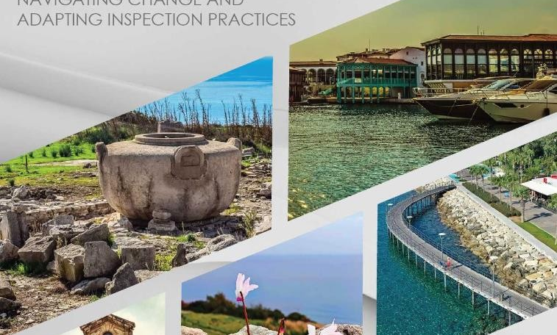

Slide 2
The SICI Workshop
Context: Education systems are evolving rapidly due to societal, political, and technological changes. Education inspection frameworks must adapt to stay effective and relevant.
Workshop Goal: Gathered inspectorates across Europe to discuss adapting frameworks to improve educational outcomes and maintain accountability.
Focus Areas: Adapting inspection frameworks, leveraging technology, and addressing well-being and inclusion.

Slide 3
Adapting Inspection Frameworks
Need for Flexibility: Traditional inspection models are seen as too rigid. A shift towards dynamic frameworks that can be tailored to specific contexts (e.g., focusing on literacy or numeracy).
Streamlining Processes: Reducing bureaucracy to respond quickly to emerging challenges while ensuring high standards.
Balancing Accountability: Ensuring rigorous inspections without overwhelming schools with excessive administrative work.

Slide 4
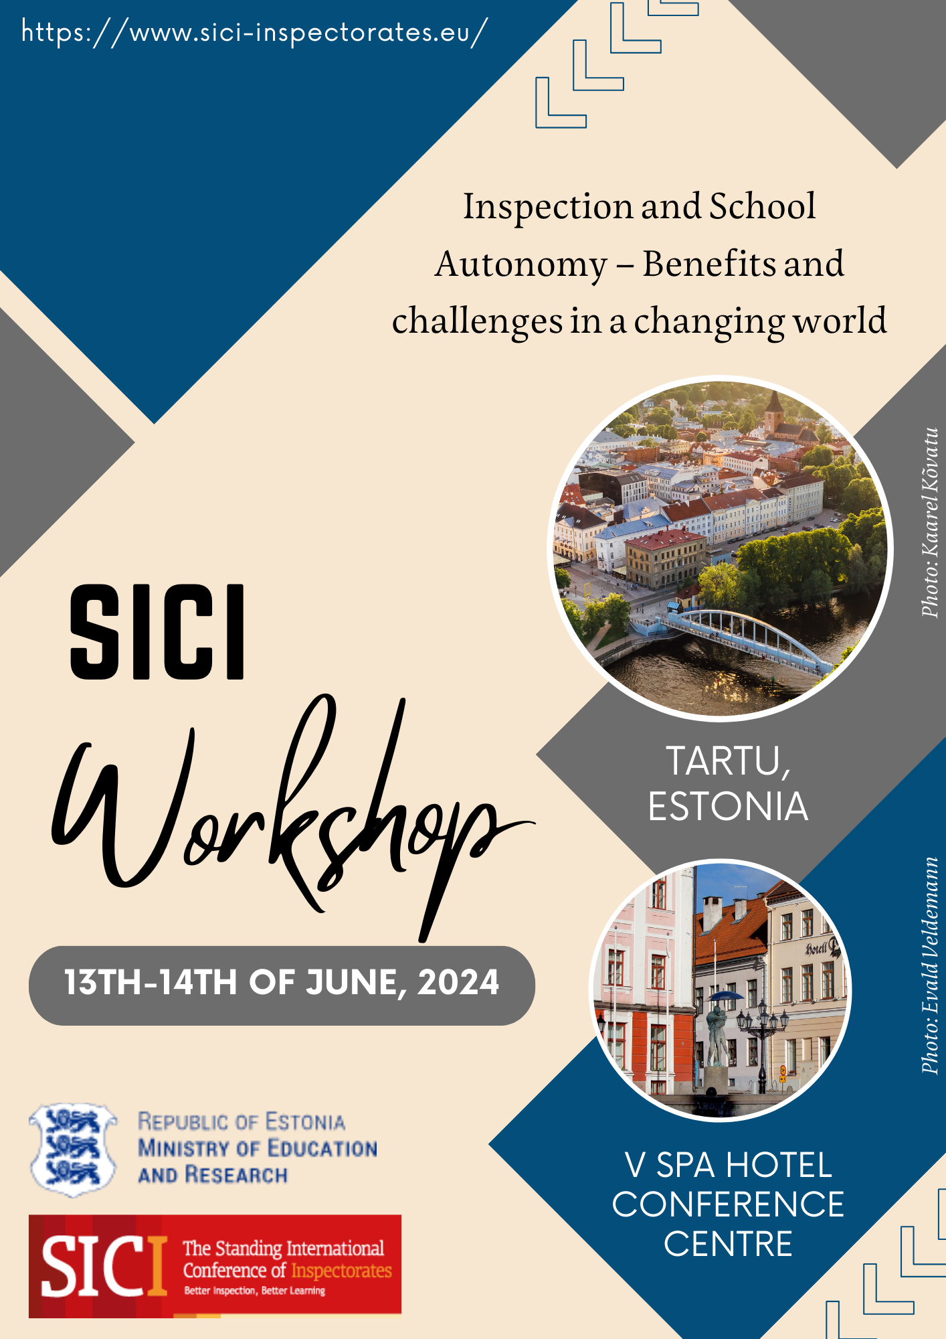



Slide 5

The Potential of School Autonomy
Autonomy can drive innovation by allowing schools to design customized curricula and pedagogical approaches that better meet student needs.
This flexibility enables more relevant and engaging learning experiences, tailored to individual school communities.
However, autonomy must be balanced with accountability to ensure consistent quality and equity across the education system.

Slide 6
The Evolving Role of Inspection
Inspections remain crucial for maintaining educational standards in autonomous schools, promoting accountability, transparency, and quality.
Modern inspections emphasize constructive feedback, support for self-evaluation, and professional dialogue with schools.
Inspectors play a vital role in addressing inequities, ensuring all students have access to high-quality education regardless of school autonomy.

Slide 7

Future Directions and Challenges
Balancing autonomy with inspection is dynamic and will adapt to new educational challenges.
Emerging trends, such as artificial intelligence (AI), could transform education by providing real-time insights into student progress and enhancing schools' improvement processes.
The workshop emphasized the need to re-evaluate the autonomy-inspection balance to maintain equity, quality, and innovation as systems evolve.

Slide 8
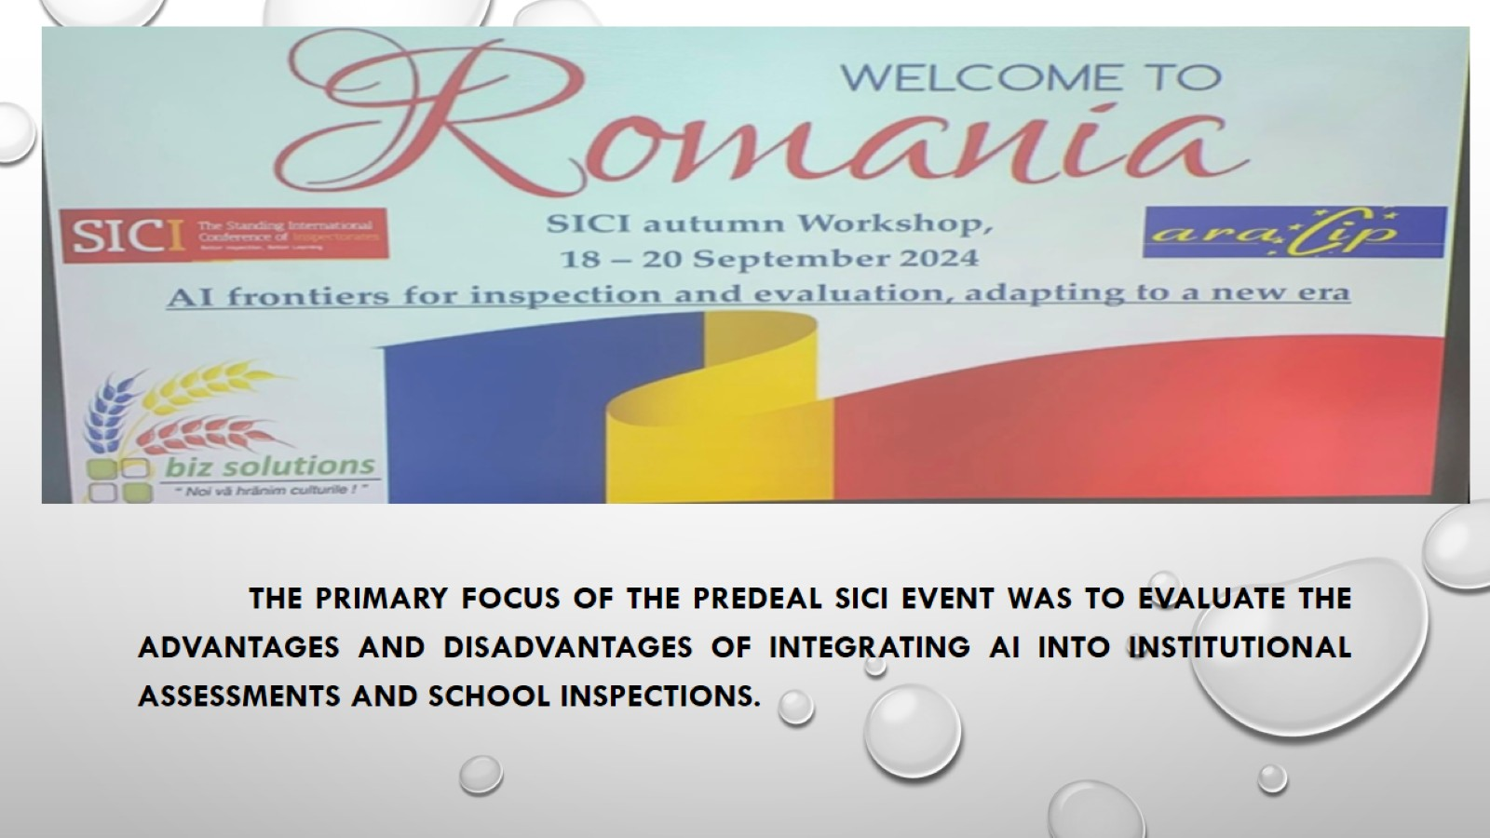

Slide 9
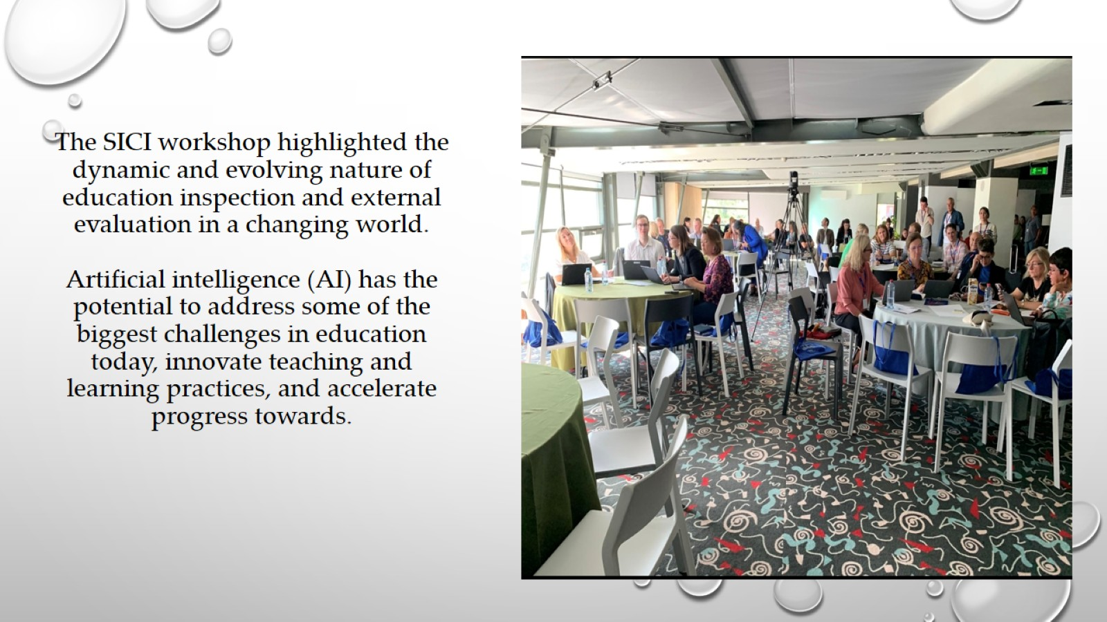
The SICI workshop highlighted the dynamic and evolving nature of education inspection and external evaluation in a changing world. Artificial intelligence (AI) has the potential to address some of the biggest challenges in education today, innovate teaching and learning practices, and accelerate progress towards.

Slide 10
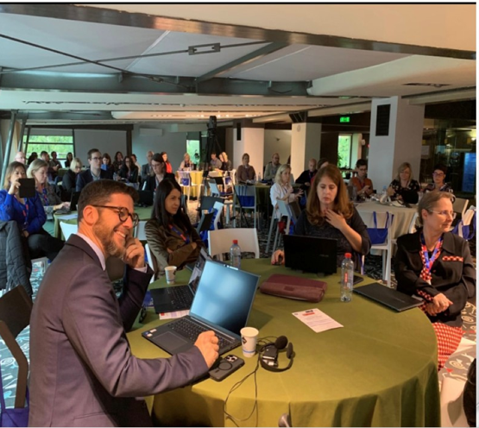
The initial phase in the development of educational resources is the demonstration by romanian experts regarding the use of artificial intelligence (AI) to create dynamic and captivating educational materials for students. The second is the personalization of learning, which entails the integration of ai into the curriculum to customize the educational experience of each student.
The primary focus raised by kenotes speakers was that through AI we can create valuable resources , dynamic and captivating educational materials for students.
The second is the personalization of learning which entails the integration of AI into curriculum to customize students’ experience of learning

Slide 11
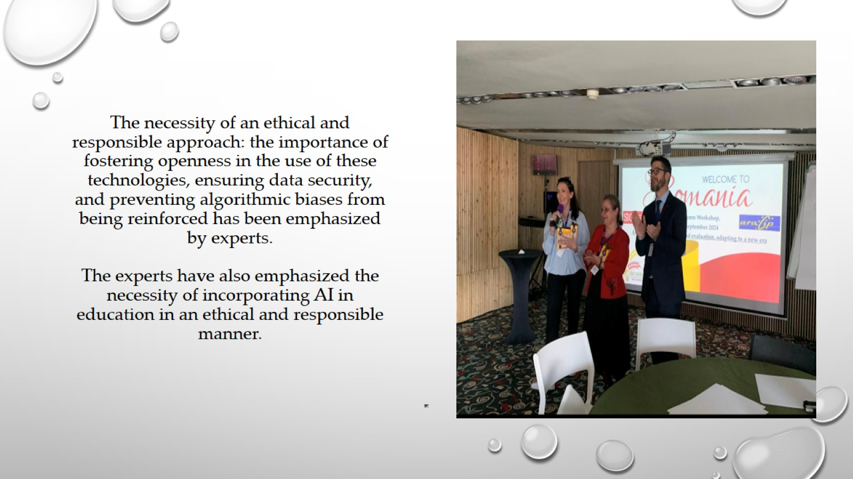
The necessity of an ethical and responsible approach: the importance of fostering openness in the use of these technologies, ensuring data security, and preventing algorithmic biases from being reinforced has been emphasized by experts. The experts have also emphasized the necessity of incorporating AI in education in an ethical and responsible manner.

Slide 12
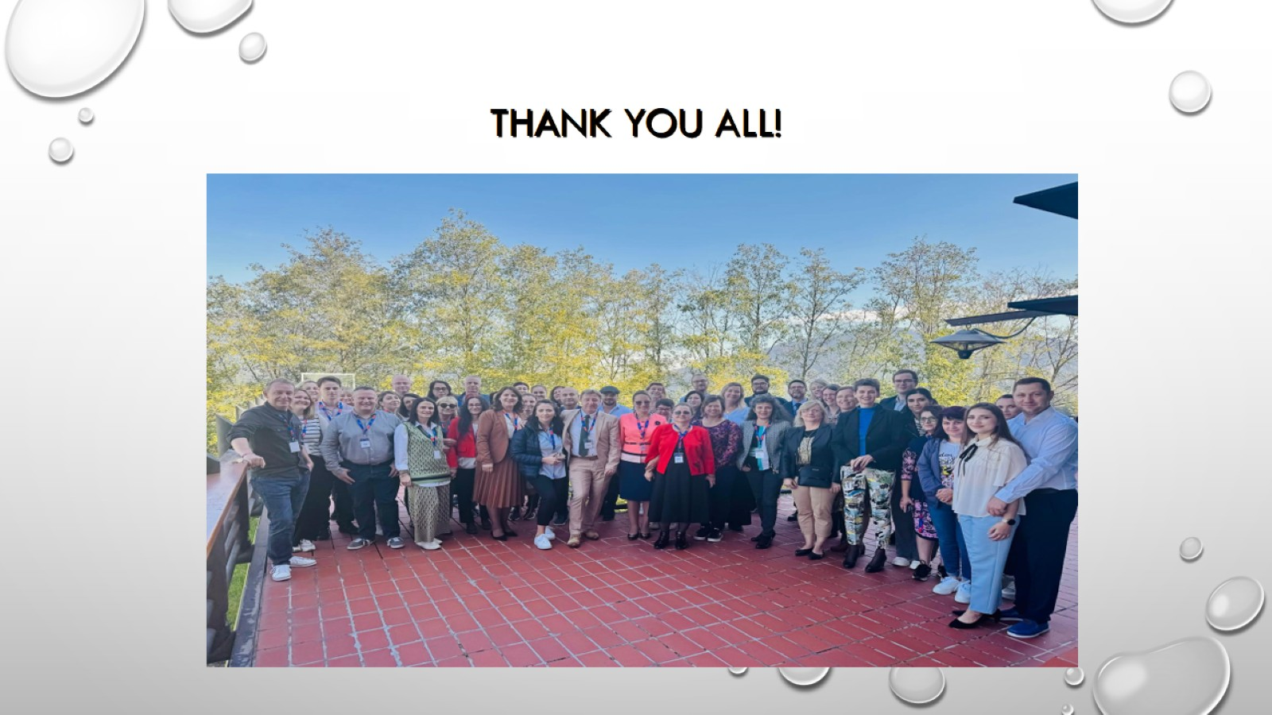
thank you all!

